Slide 1


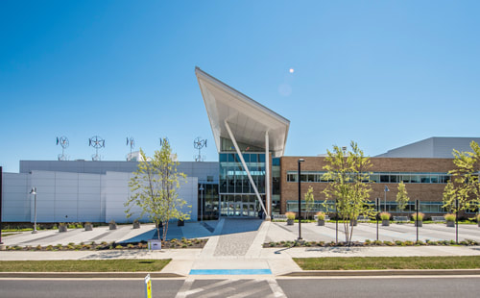




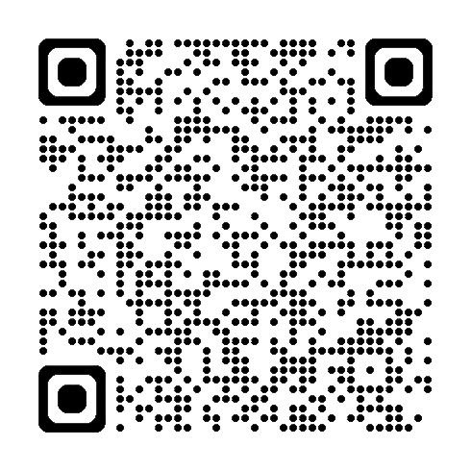







Hosted in partnership with the Office of Student Employment Services
&
The Natural Sciences and Engineering Department
STEM SYMPOSIUM:
Job Fair &
Career Panel
THURS.,
NOVEMBER
Connect. Network. Launch Your Future.
Meet STEM employers, gain inside career advice, and explore internships and job opportunities through an engaging industry panel and live Q&A.
12
GERMANTOWN CAMPUS
Bioscience Education Center (BE),
Rooms 151/152
10 AM – 2 PM
Career Panel:
10 AM – 11 AM
Scan QR Code to Register
RECRUITING AT THIS EVENT…
Panda Programmer
Job Fair:
11 AM – 2 PM
Plus, more!
FREE to all MC students, alumni, faculty & staff. • Bring your résumé!
Please contact the Student Employment Services Office with any questions. SES_MC@montgomerycollege.edu

