Slide 1
Enhancing Budget Literacy &
Building the Proposed FY18 Budget
Office of Budget
Donna Schena
Linda Hickey
Helen Dong

Slide 2
Presentation Overview
Budget definition & purpose
Budgets at Montgomery College
Operating fund revenue sources
Operating fund expenditures
Annual budget development process

Slide 3
Presentation Overview
FY18 President’s Budget Initiatives
FY18 Current Fund Budget: Revenue & Expenditure Assumptions
FY18 Current Fund Budget: Structural Gap
Realities of an Unsustainable Pattern
Structural Gap Solutions

Slide 4
Budget Definition & Purpose
What is a budget?
A plan for an organization’s outgoing expenses and incoming revenues for a specific period of time.
What is the purpose of a budget?
Plan, track, and control spending.
The purpose is to ensure that spending follows a plan, stays within preset limits, and does not exceed available funds.
Support funding requests.
The purpose is to justify funding requests by showing how funds are used.
2

Slide 5
Budgets at Montgomery College
Operating Fund aka Current Fund* Emergency Plant Maintenance and Repair Fund* County Grant Fund* Workforce Development and Continuing Education Fund Auxiliary Enterprises Fund | Transportation and Major Facilities Reserve Fund⁺ Federal, State, and Private Grants MC 50th Endowment Fund Student Activities and Athletics⁺ MC Cable TV Capital Budget
*Tax supported by County Residents | ⁺Supported through student fee
Notes:
Operating Budget
A budget that allocates to 6 distinct functional areas (instruction, academic support, student services, operation & maintenance, institutional support, and scholarships) that make up the College’s operations.
Montgomery College’s operating revenue comes through three main sources:*
Montgomery County
Tuition and Fees
State Aid
Capital Budget
A budget that allocates funds for the acquisition or maintenance of fixed assets such as land, buildings, and equipment.
Montgomery College’s capital budget is primarily funded by the County and State.*
*There are additional budget sources, but these are the main sources
Information Technology
Student systems
Technology infrastructure
Data center support
Technology equipment

Slide 6
Operating Fund Revenue Sources
FY17 Budget
Notes:
Operating Fund Revenue Sources
County contribution – Maintenance of Effort
Tuition and Fees – Board of Trustees approved
State Aid
Based on Full Time Equivalent enrollment
Student registration status
Fund Balance
Miscellaneous

Slide 7
Operating Fund Expenditures by Function
FY17 Budget
Notes:
Operating Fund Expenditures by Function
Instruction
Academic Support
Student Services
Operation and Maintenance of Plant
Institutional Support
Scholarship and Fellowship
A functional expense classification is a method of grouping expenses according to the purpose for which the costs incurred. It tells why an expense was incurred rather than what was purchased.

Slide 8
Operating Fund Expenditures by Object
FY17 Budget
Notes:
A natural expense classification is a method of grouping expenses according to the type of costs incurred. It tells what was purchased rather than why an expense was incurred.

Slide 9
Annual Budget Development Process
June – September
Calculate same service level costs
Outline Senior Advisory Leadership Team (SALT) initiatives
Evaluate compensation commitments
Establish institutional priorities for upcoming budget
October – November
Finalize revenue outlook for upcoming fiscal year
Review of draft budget by SALT
Review draft budget by Board of Trustees Financial Sustainability Committee

Slide 10
Annual Budget Development Process
December
Present draft budget to the Board of Trustees
January
Draft budget request adopted by Board of Trustees
Adopted budget submitted to the County Executive
March
County Executive publicly issues his budget for all County agencies and for Montgomery College

Slide 11
Annual Budget Development Process
April – May
Public hearings on County Executive budget
County Council Education Committee reviews budget
Full County Council review and vote on College submission
June
Board of Trustees adopts budget

Slide 12
Building the Proposed FY18 Budget
“Don’t tell me what you value,
show me your budget and I will
tell you what you value.”
- Vice President Joe Biden

Slide 13
FY18 President’s Budget Initiatives
Student Learning and Completion
Achieving the Dream
Student Access and Affordability
Scholarships
Open Education Resources (OER)
Commitment to Our Employees
Collective Bargaining Agreements
Safety and Security

Slide 14
FY18 President’s Budget Initiatives (cont.)
Institutional Effectiveness/Sustainability and Stewardship
REIMAGINE services and RETHINK work
Kickoff Blue Ribbon committee – December 2016
Continue to implement compensation and classification study
Advance strategic enrollment plan
Revamp advising and scheduling courses
Enhance use of data for decision-making

Slide 15
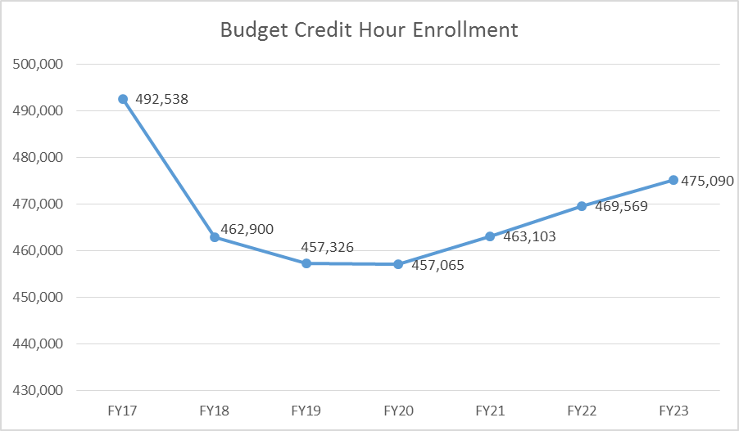
Proposed FY18 Current Fund Budget Revenue Assumptions
Tuition and Fees
Credit hour enrollment – 462,900 hours projected*
29,638 hours lower than FY17 budget
* Note: Not final

Slide 16
FY18 Current Fund Budget Revenue Assumptions
State Aid
Update January 2017
Other Revenue
Use Follett to fund the operating budget
Fund Balance
Make up $4.5 million one-time use in FY2017
County Request (to be finalized by the Board of Trustees in January 2017)
Notes:
State Aid – Decrease in revenue from FY17 of $594,410
The College’s State Aid eligible FTE dropped from 18,263.07 in FY17 to 17,999.79 in FY2018
The College’s internal calculation allocates state aid between operating and WDCE based on their percentage of the total. Operating FTE percentage decreased resulting in a lower percentage of the state aid as compared to last year or $594,410 in less state aid
Still unknown is what the Governor will propose in January 2017 – Will we be held harmless or will any of the components change positively or negatively that make up the state aid formula to community colleges?
d note here to discuss the State Aid reduction

Slide 17
FY18 Current Fund Budget Expenditure Assumptions
Compensation
Salary/FICA increases
County minimum wage change
Employee benefits
Same services
President’s Initiatives
ATD
Safety and Security
Open Education Resources

Slide 18
FY18 Current Fund Budget Structural Gap
Projected Revenue $4.0 MILLION (excludes County ask)
Projected Expenditures $ 8.7 MILLION (excludes initiatives)
Projected Gap (before County ask) $ 12.7 MILLION
7
7

Slide 19
Realities of an Unsustainable Pattern
Institutional Challenges
Credit hour enrollment projection = FY2007
Decline in credit hour enrollment affects State aid
Past wage increases (5-7%) are not sustainable
Funding Source Challenges
County government is facing economic and political challenges
Revenues are rising (very slightly)
Passing of term limits
MCPS has increasing enrollments
Currently 50% of County budget

Slide 20
Structural Gap Solutions
Maintain focus on achieving student success
Recommended actions:
Reductions to the base budget
Efficiencies
Additional resources and partnerships
Notes:
While we are faced with a structural budget gap our budget and actions will not lose sight of focusing on student success.
Some of the recommended actions that are going forward include
Raising our tuition by 2.9% (this is the percent increase based on an academic year tuition cost)
We are putting forth recommended reductions to our base such as
1) elimination of 15 to 20 vacant positions
2) Zero funding faculty positions
3) Adhering to the county lapse request
4) Other salary account reductions
5) non-salary account reductions.
As we put forth our reductions we are also paying particular attention to efficiencies and additional resources and partnerships that should arise from our review.

Slide 21
Questions

